Slide 1
Trie

Slide 2
Task
Let's imagine the following task: we have a set of strings, and we need to support three types of queries:
Add a string to the set
Remove a string from the set
Check if a string is in the set.

Slide 3
insert(abc)
s = {abc}

Slide 4
insert(aba)
s = {abc, aba}

Slide 5
insert(ba)
s = {abc, aba, ba}

Slide 6
insert(ba)
s = {abc, aba, ba}

Slide 7
remove(ba)
s = {abc, aba}

Slide 8
find(ba), no
s = {abc, aba}

Slide 9
Trie
Let's construct a tree where each edge contains a letter. Moreover, let's agree that from any given vertex, there can only be one edge with each letter

Slide 10
a
b
c
a
b

Slide 11
Path
It can be noted that any path from the root to a certain vertex represents a word.

Slide 12
ca
a
b
c
a
b

Slide 13
Terminal vertices
We will consider that some vertices are marked as terminal.
Words that end at terminal vertices will be considered words from the dictionary.

Slide 14
set = {b, ca}
a
b
c
a
b

Slide 15
What we can now?
Now we are able to check if a string is in the set, add it to the set, or remove it from the set in O(length(string)) time.

Slide 16
What we can now?
Also, for example, we can find all strings in the set by simply performing a DFS (depth-first search) on the trie.
It will works for O(sum_length) time.

Slide 17
a
b
c
a
b

Slide 18
string = a
a
b
c
a
b

Slide 19
string = c
a
b
c
a
b

Slide 20
string = ca, cout << ca;
a
b
c
a
b

Slide 21
string = cb
a
b
c
a
b

Slide 22
string = b, cout << b
a
b
c
a
b

Slide 23
How to implement?
How to generally implement such a structure.
We will create a structure vertex, which in some form, will hold pairs {letter, reference to the vertex with an edge on that letter}.

Slide 24
How to implement?
That is, we have an Interface vertex, which has methods like add_edge, which adds a pair {letter, reference to the vertex with an edge on that letter}.
And some method go_by_letter, which takes the necessary pair and returns the vertex for that character.

Slide 25
How to implement?
We need to implement structure, which will storage pairs {letter, reference to the vertex with the edge by that letter}.
There are two ways to do this:
If the alphabet is small enough and we know it, then we can just make an array of edges.
Otherwise, we can create a dictionary {char, reference}.

Slide 26
How to implement?
For such structures representing tree structures, there are two main solutions:
Pointers or references in the case of higher-level languages (I honestly won't write a destructor in C++ code)
A vector of structures
We will consider each of them and then discuss their advantages and disadvantages.

Slide 27
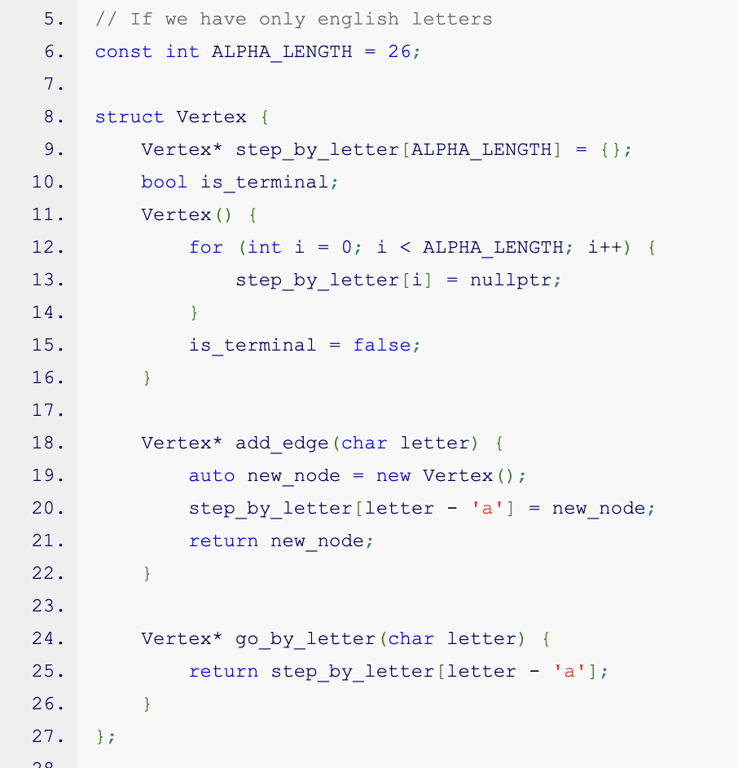

Slide 28
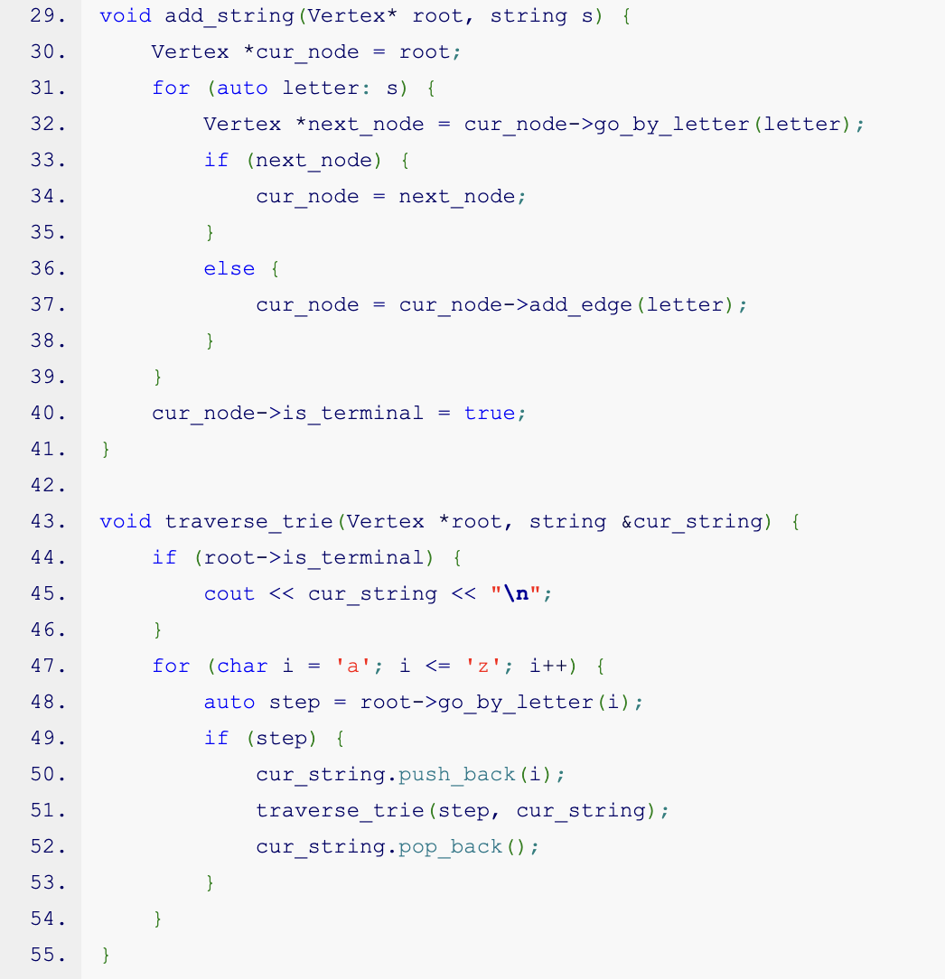

Slide 29
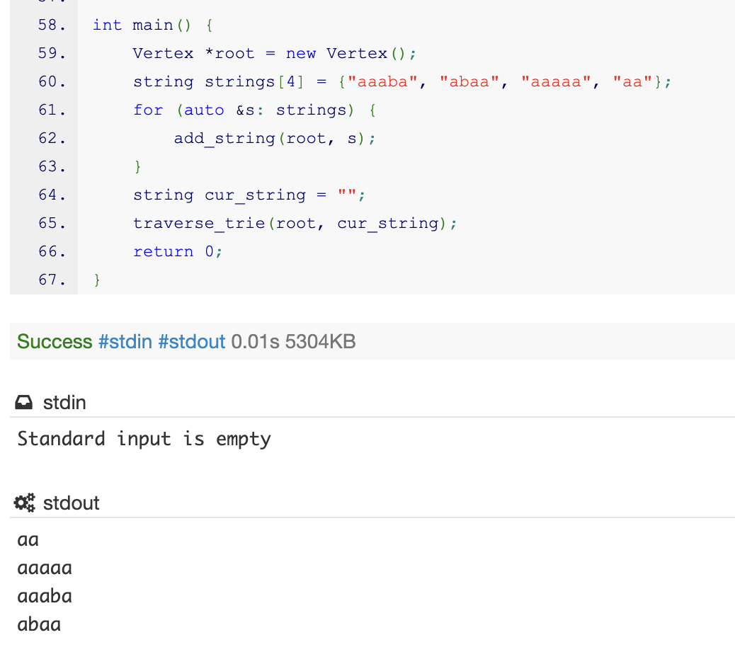

Slide 30
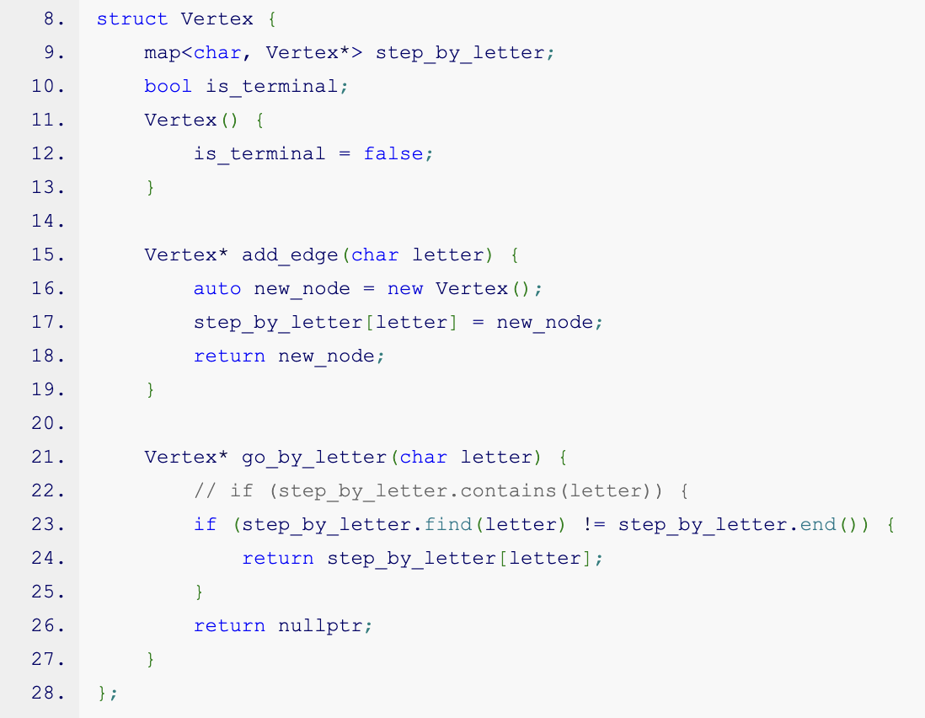

Slide 31
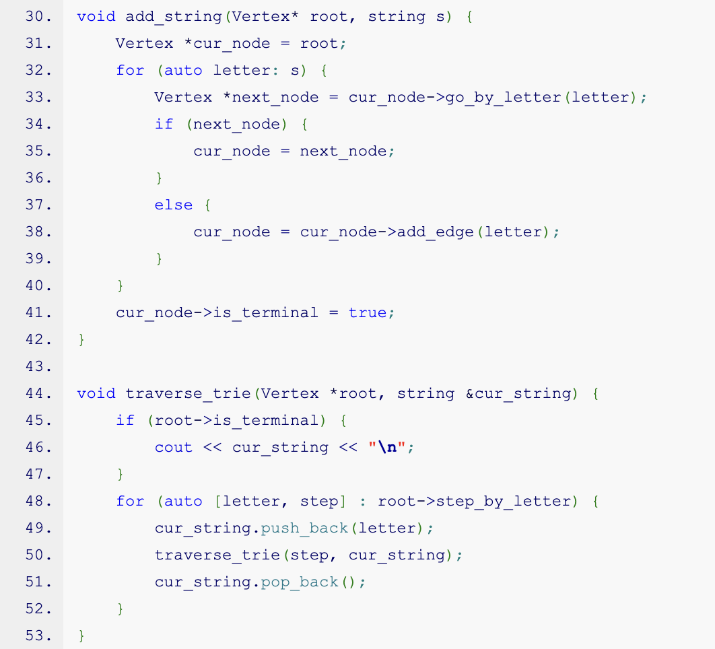

Slide 32
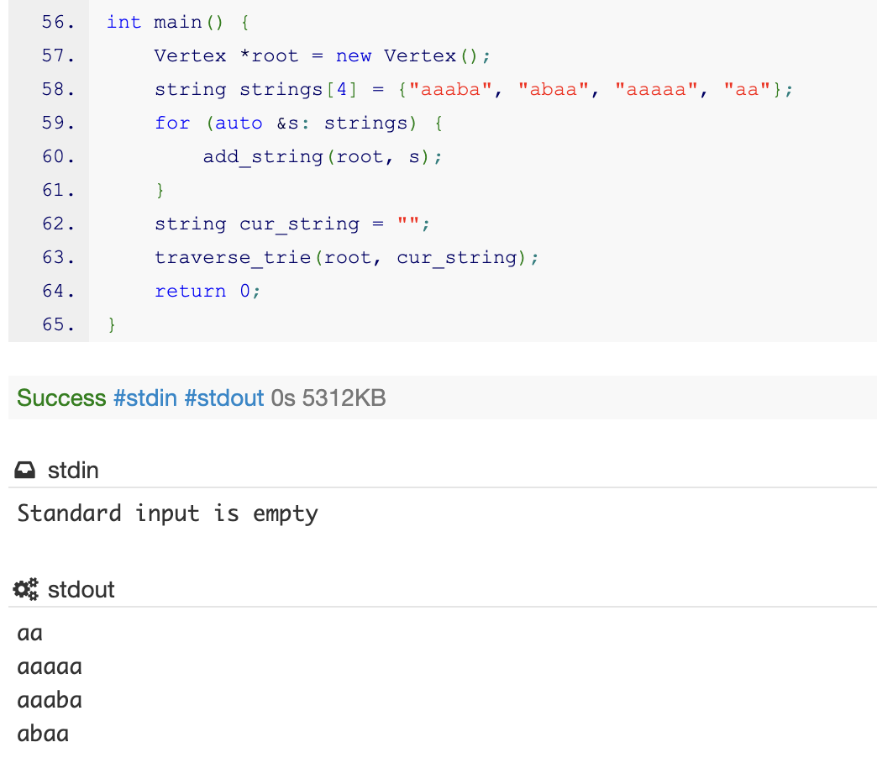

Slide 33
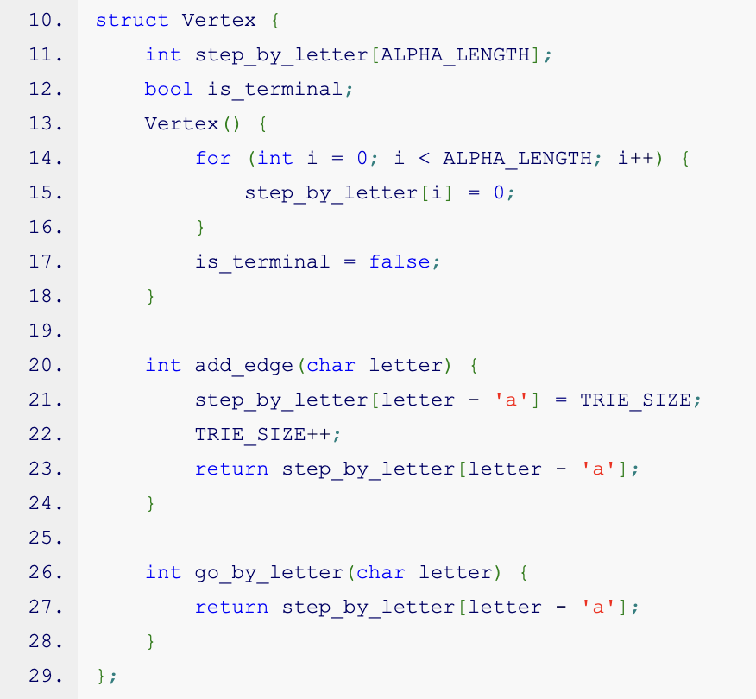

Slide 34
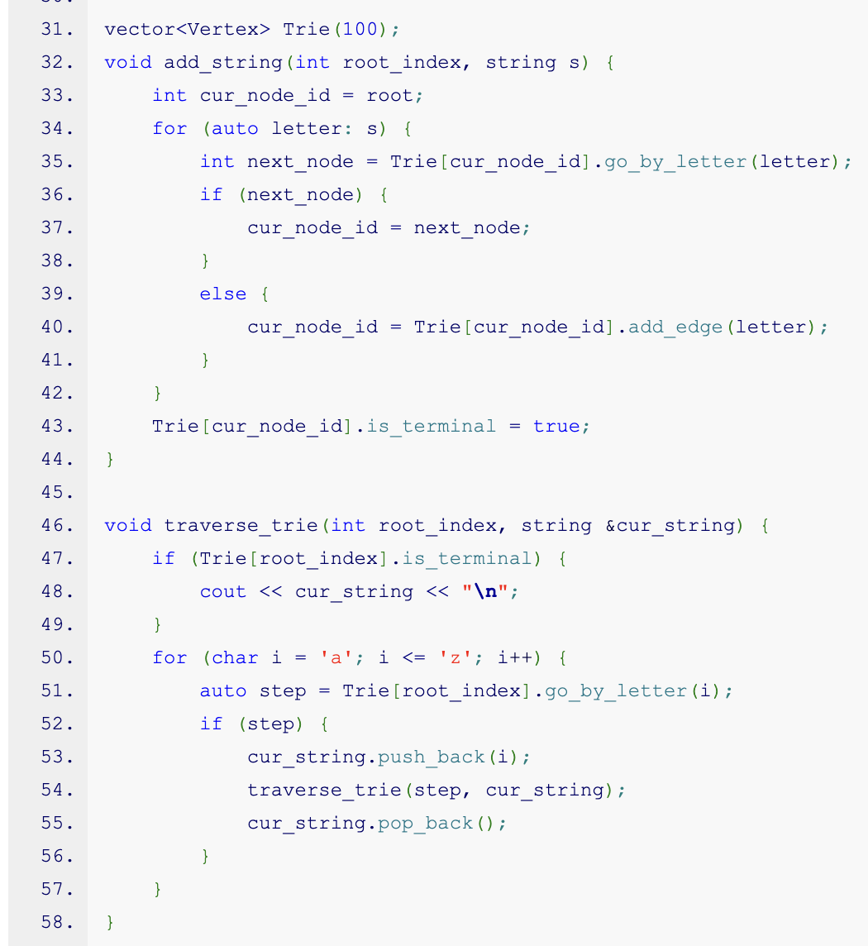

Slide 35
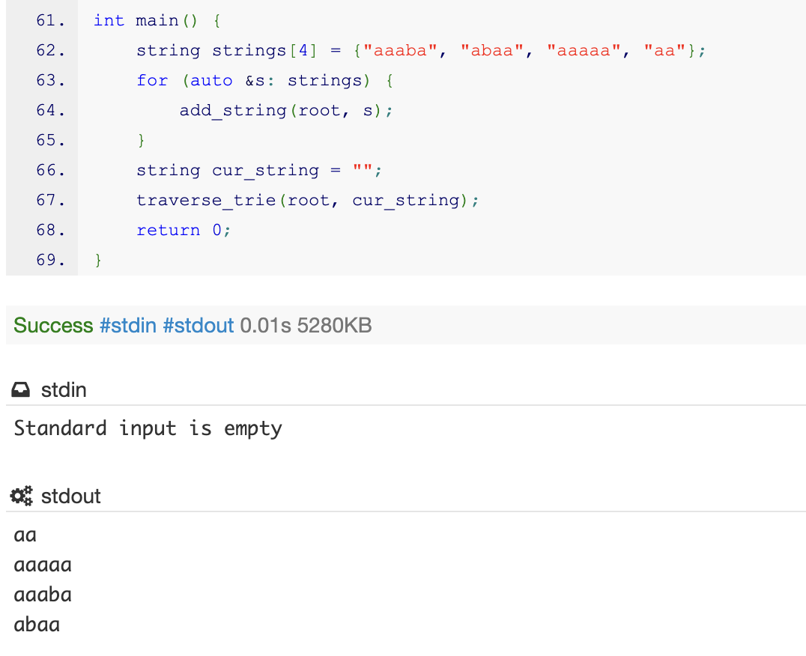

Slide 36
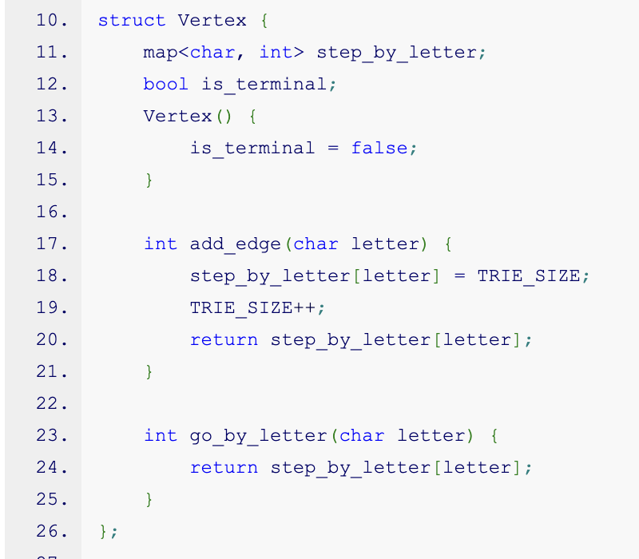

Slide 37
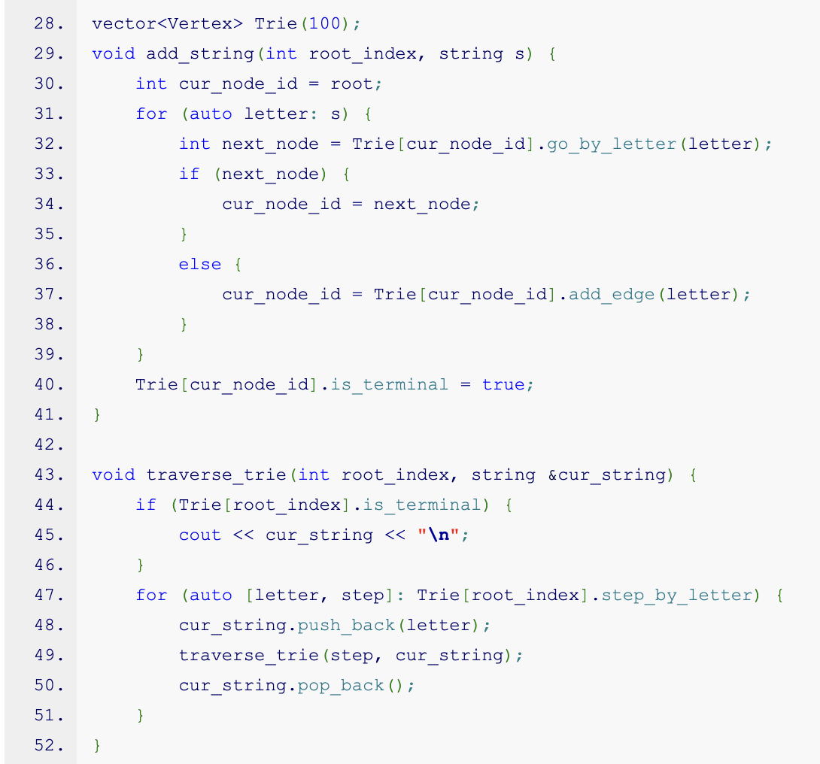

Slide 38
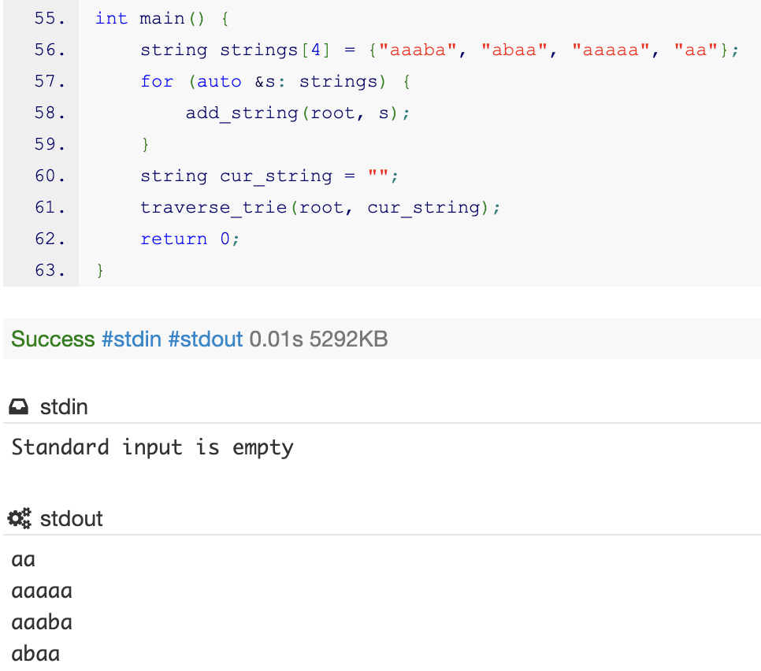

Slide 39
Trie traversal
An interesting note is that if we traverse the trie and in that traversal we will check the edges from the smaller letter to the larger, we will pass all the words in lexicographical order. In total, we get a sort for n * alpha, where n is the total length of the text.

Slide 40
k-th string
In fact, now we can solve a huge range of problems. For example, let's find the k-th string in lexicographical order.
To do this, let's calculate additional dp - how many strings end (or how many terminal vertices are in the subtree of vertex i).

Slide 41
set = {b, ca, cb}
3
a
b
c
0
1
2
a
b
1
1

Slide 42
k-th string
dp[i] - answer for vertex i.
dp[leaf] = is_term(leaf).
calculate in dfs order.
dp[v] = sum(dp[sons]) + is_term(v)
answer - dp[vertex]

Slide 43
set = {b, ca, cb}, red - active_in_dfs, black - not visited yet, blue - finished
a
b
c
a
b

Slide 44
set = {b, ca, cb}, red - active_in_dfs, black - not visited yet, blue - finished
a
b
c
a
b

Slide 45
set = {b, ca, cb}, red - active_in_dfs, black - not visited yet, blue - finished
0
a
b
c
0
a
b

Slide 46
set = {b, ca, cb}, red - active_in_dfs, black - not visited yet, blue - finished
0
a
b
c
0
a
b

Slide 47
set = {b, ca, cb}, red - active_in_dfs, black - not visited yet, blue - finished
0
a
b
c
0
a
b
1

Slide 48
set = {b, ca, cb}, red - active_in_dfs, black - not visited yet, blue - finished
0
a
b
c
0
1
a
b
1

Slide 49
set = {b, ca, cb}, red - active_in_dfs, black - not visited yet, blue - finished
0
a
b
c
0
1
a
b
0
1

Slide 50
set = {b, ca, cb}, red - active_in_dfs, black - not visited yet, blue - finished
0
a
b
c
0
2
a
b
1
1

Slide 51
set = {b, ca, cb}, red - active_in_dfs, black - not visited yet, blue - finished
2
a
b
c
0
2
a
b
1
1

Slide 52
set = {b, ca, cb}, red - active_in_dfs, black - not visited yet, blue - finished
2
a
b
c
0
1
2
a
b
1
1

Slide 53
set = {b, ca, cb}, red - active_in_dfs, black - not visited yet, blue - finished
3
a
b
c
0
1
2
a
b
1
1

Slide 54
set = {b, ca, cb}, red - active_in_dfs, black - not visited yet, blue - finished
3
a
b
c
0
1
2
a
b
1
1

Slide 55
k-th string
To find the k-th string now, let's check all the transitions at each step and choose the one inside which lies the k-th string. For example, if we need the 1st string (numbering from zero), then we will go to the transition by the letter 'b', as there lies 1 string, but if we need the third one, then we will go by the letter 'c'.

Slide 56
red - active_in_search, red edge, try to go by it, k = 3, amount = 0, 0 < 3 - ignore
3
a
b
c
0
1
2
a
b
1
1

Slide 57
red - active_in_search, red edge, try to go by it, k = 3, amount = 1, 1 < 3 - ignore
3 - 1 = 2, need to find in next tree
3
a
b
c
0
1
2
a
b
1
1

Slide 58
red - active_in_search, red edge, try to go by it, k = 2, amount = 2, 2 >= 2 - go by it
3
a
b
c
0
1
2
a
b
1
1

Slide 59
red - active_in_search, red edge, try to go by it, k = 2, amount = 1, 1 < 2
k - 1 = 1, check next tree
3
a
b
c
0
1
2
a
b
1
1

Slide 60
red - active_in_search, red edge, try to go by it, k = 1, amount = 1, 1 >= 1, go inside
3
a
b
c
0
1
2
a
b
1
1

Slide 61
final vertex, answer = cb
3
a
b
c
0
1
2
a
b
1
1

Slide 62
Digit trie
Instead of storing strings in the trie, we can store numbers, and then we can perform very interesting operations with numbers. Usually, in a trie, either numbers in the decimal system or in binary are stored.
Also, it is usually necessary for the numbers to be of equal length, and for this purpose, they are filled with leading zeros.

Slide 63
set = {10, 101, 1}
0
1
0
1
0
1
0
1

Slide 64
Task
What kind of problems can be solved in this way?
Usually, it's the problem of searching for some optimal number.
For example - there is a set of numbers, and it is required to respond to two types of queries:
Find a number from the set, the xor of which with x_i is maximal
Add the number x_i to the set

Slide 65
Solution
Let's build a trie from a set of numbers. The insertion of a number will work just like the insertion of a string into a trie.
For searching, we can proceed greedily, let's go through the digits of the number x_i and each time try to take the opposite value. If it's not possible, then we take the same value.

Slide 66
set = {10, 101, 1}, x_i = 111, x_i[0] = 1, try to go by 0
0
1
0
1
0
1
0
1

Slide 67
set = {10, 101, 1}, x_i = 111, x_i[1] = 1, try to go by 0
0
1
0
1
0
1
0
1

Slide 68
set = {10, 101, 1}, x_i = 111, x_i[2] = 1, try to go by 0, no such edge, go by 1
0
1
0
1
0
1
0
1

Slide 69
answer = 001 = 1
0
1
0
1
0
1
0
1

Slide 70
Why we can do greedy?
At each step, it is advantageous for us to choose greedily because if we select the opposite value at the i-th step, then we will add 2^(n - i) to the answer. However, if we take all the good values at the following steps, we can only get (2^0 + 2^1 + 2^2 + .. + 2^(n - i - 1)) = 2^(n - i) - 1.

Slide 71
Aho–Corasick algorithm
Let there be a set of strings {s_1, .. s_n}, called a dictionary, and a large text t. It is necessary to find all positions where the dictionary strings enter the text. For simplicity, let's additionally assume that the strings from the dictionary are not substrings of each other (later we will see that this requirement is redundant).

Slide 72
Example
{s_1, .. s_n} = {“aba”, “da”, “ac”}
t = dabac
answer = {0, 1, 3}

Slide 73
Solution
First, let's consider a super trivial example where the strings do not contain any common characters at all.

Slide 74
set = {aa, bbb, cc}
a
c
b
a
c
b
b

Slide 75
Solution
Then let's simply go through our trie if there is an edge, and if there isn't, then return to the root vertex.

Slide 76
set = {aa, bbb, cc}
not c
a
c
b
a
c
not b
b
any
b

Slide 77
Automaton
Such a structure is generally called an automaton.
First, let's discuss informally what an automaton is.
An automaton is a set of states and transitions between them. In the case of strings, we will consider that a transition is a letter. If we can reach some terminal vertex via the automaton, it means that the automaton accepts the word obtained in such a way.

Slide 78
Automaton
We will consider that a Deterministic Finite Automaton (DFA) A is <Q, ∑, δ, S_0, F>.
Q — set of automation’s states
∑ - alphabet
δ - function of transition, such as Q * ∑ -> Q
S_0 ∈ Q — starting state F ⊆ Q - set of finite states

Slide 79
abc
0
abc
a
b
c
c
1
2
3
a
b
4
5

Slide 80
Example
A = <Q, ∑, δ, S_0, F>.
Q — {0, 1, 2, 3, 4, 5}
∑ - {a, b, c}
δ - {(0, a) -> 1, (0, b) -> 2, (0, c) -> 3, (1/2, a/b/c) -> 0, (3, c) -> 0, (3, a) -> 4, (3, b) -> 5}
S_0 = 0 F = {4, 5}

Slide 81
Initial task
Let's return to the original problem and solve it again, but now with weaker constraints - let's agree that no string s_i is a substring of s_j.
We need to understand where to transition from any vertex by any letter, and then we will obtain a complete automaton.

Slide 82
Steps
What would we do if there is no edge by letter in the trie.
Let's think, for example, we are currently standing in some vertex of the trie, which means the string 'aba', and we want to make a step by the letter 'c'.

Slide 83
Steps
Ideally, we would like to make a step to the word 'abac', but if it doesn't exist, we would want to make a step to 'bac', 'ac', or 'c', that is, the longest suffix of the string, because we clearly want to find some terminal string in the trie while no string is a substring of any other.
Such a reference will be called 'suffix_by_letter'.

Slide 84
0
a
b
c
1
c
c
2
b
3
a
b
6
b
4
5

Slide 85
Steps
Moreover, for the sake of simplicity of implementation, a simple suffix link is also defined. This is a link that leads to the longest suffix of the current string that exists in the trie.
We will call it 'suffix_link'.
Let’s think about its connection with the prefix function.

Slide 86
0
a
b
c
1
2
b
3
a
b
6
4
5

Slide 87
Dynamic programming?
suffix_link[v] - link to max suffix for string (root->v)
suffix_link[root] = root
edge (p, v, c) : suffix_link[v] = suffix_by_letter[p][c]
dfs order

Slide 88
Proof of formula
suffix_link[v] = suffix of path(root->v) = suffix of path((root->v) + edge(p->v))
suffix_by_letter[p][c] = suffix of string(suffix of path(root->p) + c) = suffix of string(suffix of path(root->p) + edge(p->v))

Slide 89
Dynamic programming?
suffix_by_letter[v][c] - link to max suffix for string (root->v + c)
suffix_by_letter[root][any letter] = root
if trie contains edge (v, X, c) suffix_by_letter[v][c] = X
else suffix_by_letter[v][c] = suffix_by_letter[suffix_link[v]][c]

Slide 90
Proof of formula
if trie contains edge (v, X, c) suffix_by_letter[v][c] = X
suffix_by_letter[v][c] = X, because we add c to path (root->v) and result = X

Slide 91
Proof of formula
suffix_by_letter[v][c] = suffix_by_letter[suffix_link[v]][c]
if no edge -> we go to string with less length and take the same symbol.

Slide 92
And what about substrings?
The only problem, if we allow s[i] to be a substring of s[j], is that we might find a path (root->v), and some part of the string s_path, formed by this path, is also in the trie, and we might miss it.

Slide 93
0
a
c
1
3
a
4
a
5

Slide 94
And what about substrings?
Note that such a string s# is a suffix of our string s. Consequently, the vertex corresponding to it in the trie is the suffix link of the vertex corresponding to s, or the suffix link of its suffix link, and so on up to the root.

Slide 95
0
a
c
1
3
a
4
a
5

Slide 96
Again dynamic programming?
count[v] - dp, which means amount of terminal suffix links.
count[root] = is_term[root]
in dfs order
count[v] = count[suff_link[v]] + is_term[v]

Slide 97
Final result
Let's look again at how the Aho-Corasick algorithm works, it is also called the prefix automaton.

Slide 98
Final result
First, we build a trie based on the strings s.

Slide 99
0
a
b
c
1
2
b
3
a
b
6
4
5

Slide 100
Final result
Then we need to build suffix_links and suffix_by_letter.

Slide 101
suffix_link
0
a
b
c
1
2
b
3
a
b
6
4
5

Slide 102
suffix_by_letter
0
a
b
c
1
c
c
2
b
3
a
b
6
b
4
5

Slide 103
Final result
Then we need to calculate count[u], which means amount of terminal links, that are reachable by suffix_links.

Slide 104
count_dp
0
a
b
c
1
0
b
0
a
b
0
2
1

Slide 105
count_dp
0
a
b
c
1
1
b
0
a
b
1
2
2

Slide 106
Final result
To find the number of occurrences of strings from s as substrings in t, we move through the automaton and the string t simultaneously, and each time we add count[u] if we are standing in the vertex u of the automaton.

Slide 107
Example
t = cabcb
s = {a, ca, cb, b}
answer = 1 + 1 + 1 + 2 = 5
And now we will calculate the answer using automation.
i - current symbol, red - current vertex, blue - suffix_by_letter[red][s[i]]

Slide 108
we checked t = “”, s[i] = ‘c’, suffix_by_letter[0][s[i] = ‘c’] = blue
answer = 0
0
a
b
c
1
1
b
0
a
b
1
2
2

Slide 109
we checked t = “c”, s[i] = ‘a’, suffix_by_letter[0][s[i] = ‘a’] = blue
answer = 0 + 2 = 2
0
a
b
c
1
1
b
0
a
b
1
2
2

Slide 110
we checked t = “ca”, s[i] = ‘b’, suffix_by_letter[0][s[i] = ‘b’] = blue
answer = 2 + 1 = 3
0
a
b
c
1
1
b
0
a
b
1
2
2

Slide 111
we checked t = “cab”, s[i] = ‘c’, suffix_by_letter[0][s[i] = ‘c’] = blue
answer = 3 + 0
0
a
b
c
1
1
b
0
a
b
1
2
2

Slide 112
we checked t = “cabc”, s[i] = ‘b’, suffix_by_letter[0][s[i] = ‘b’] = blue
answer = 3 + 2 = 5
0
a
b
c
1
1
b
0
a
b
1
2
2

Slide 113
Realisation
It turns out I didn't deceive you and it works.
However, this is a quite complex algorithm to implement, and there are many practical improvements to it (for example, you can quickly calculate all the links using BFS).
I will focus on the simplest possible implementation.

Slide 114
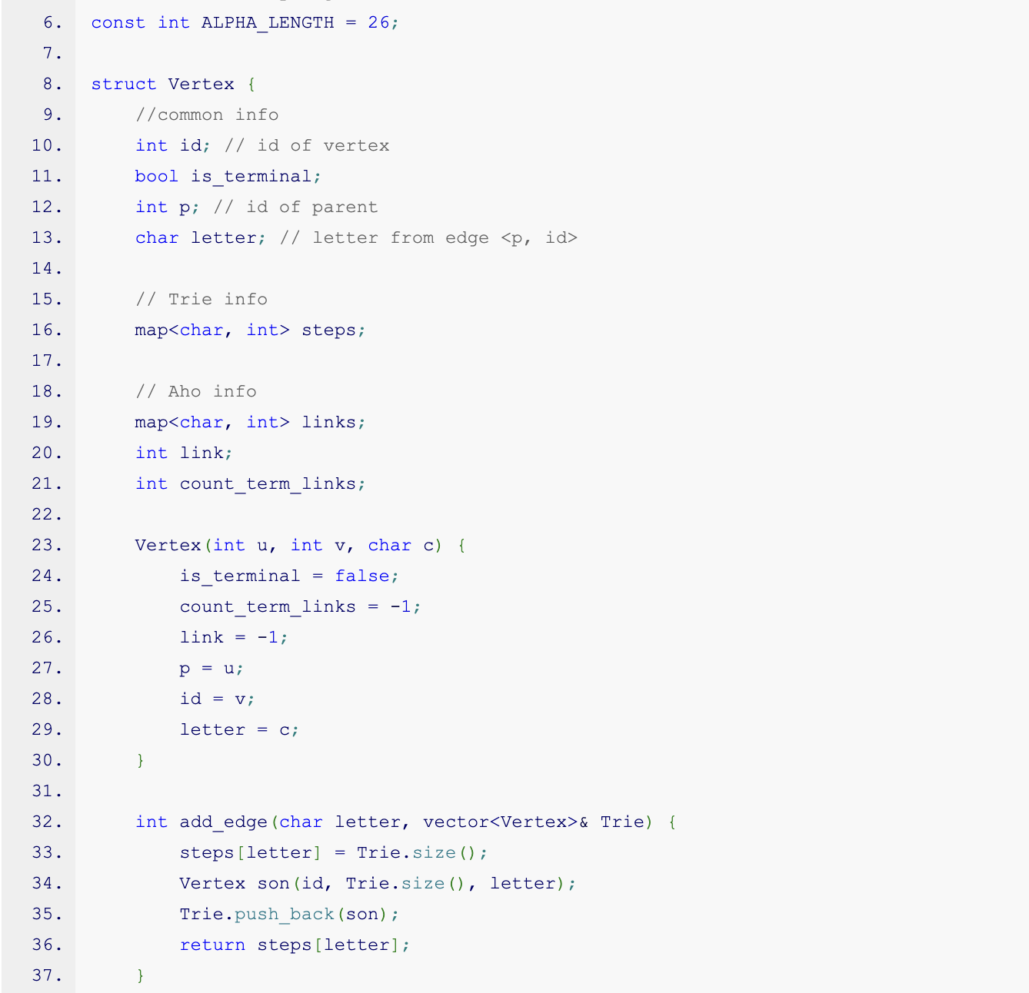

Slide 115
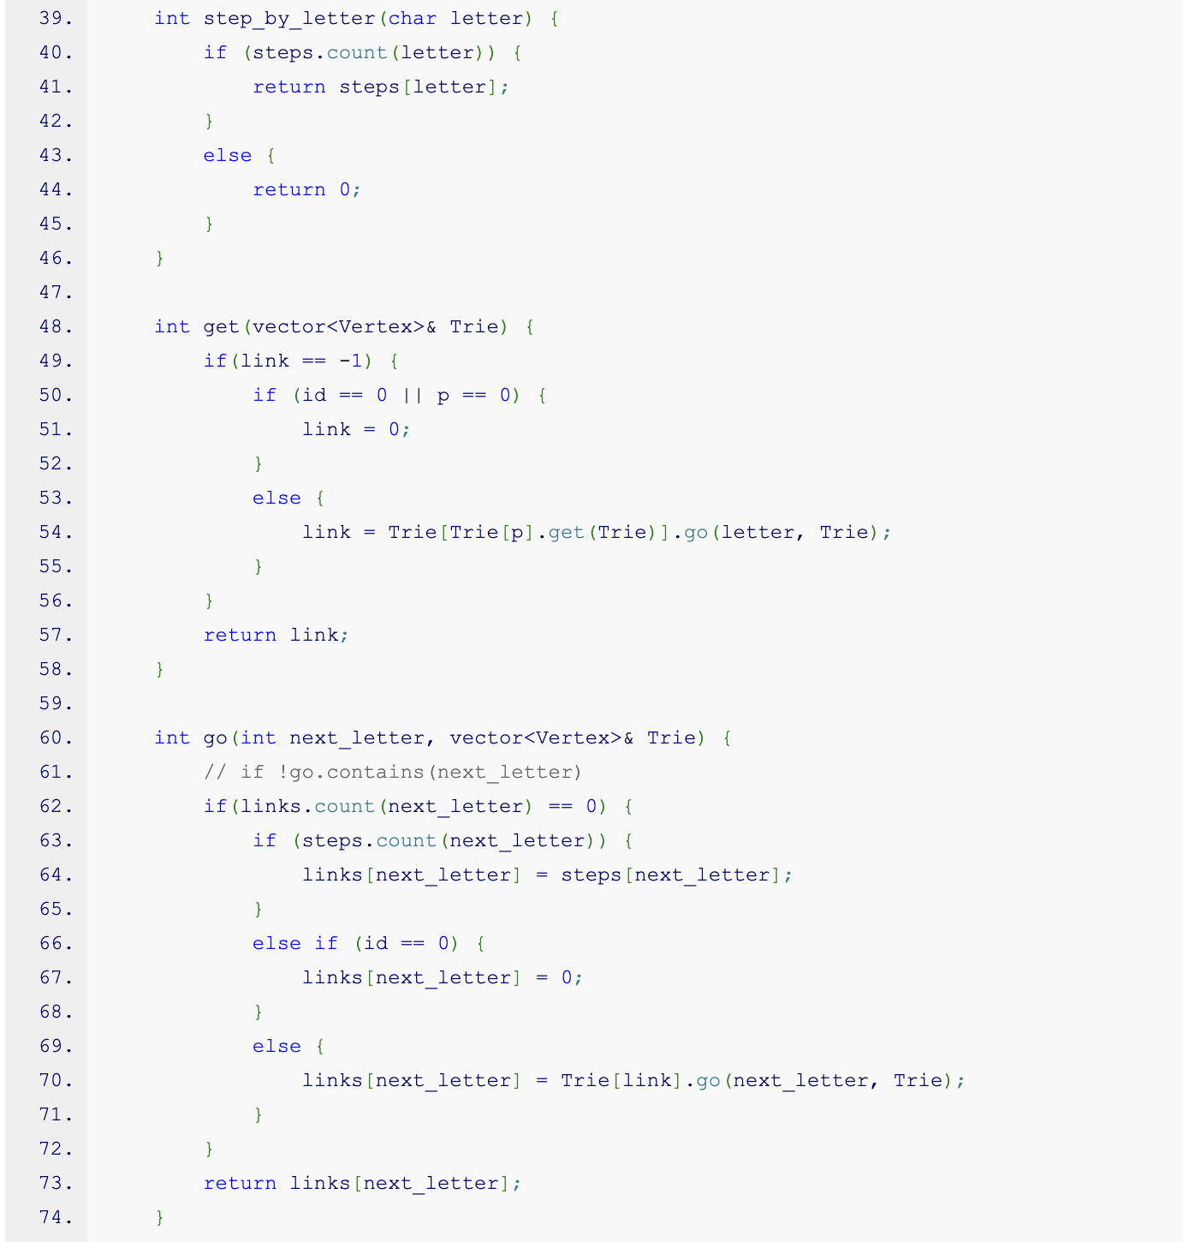

Slide 116
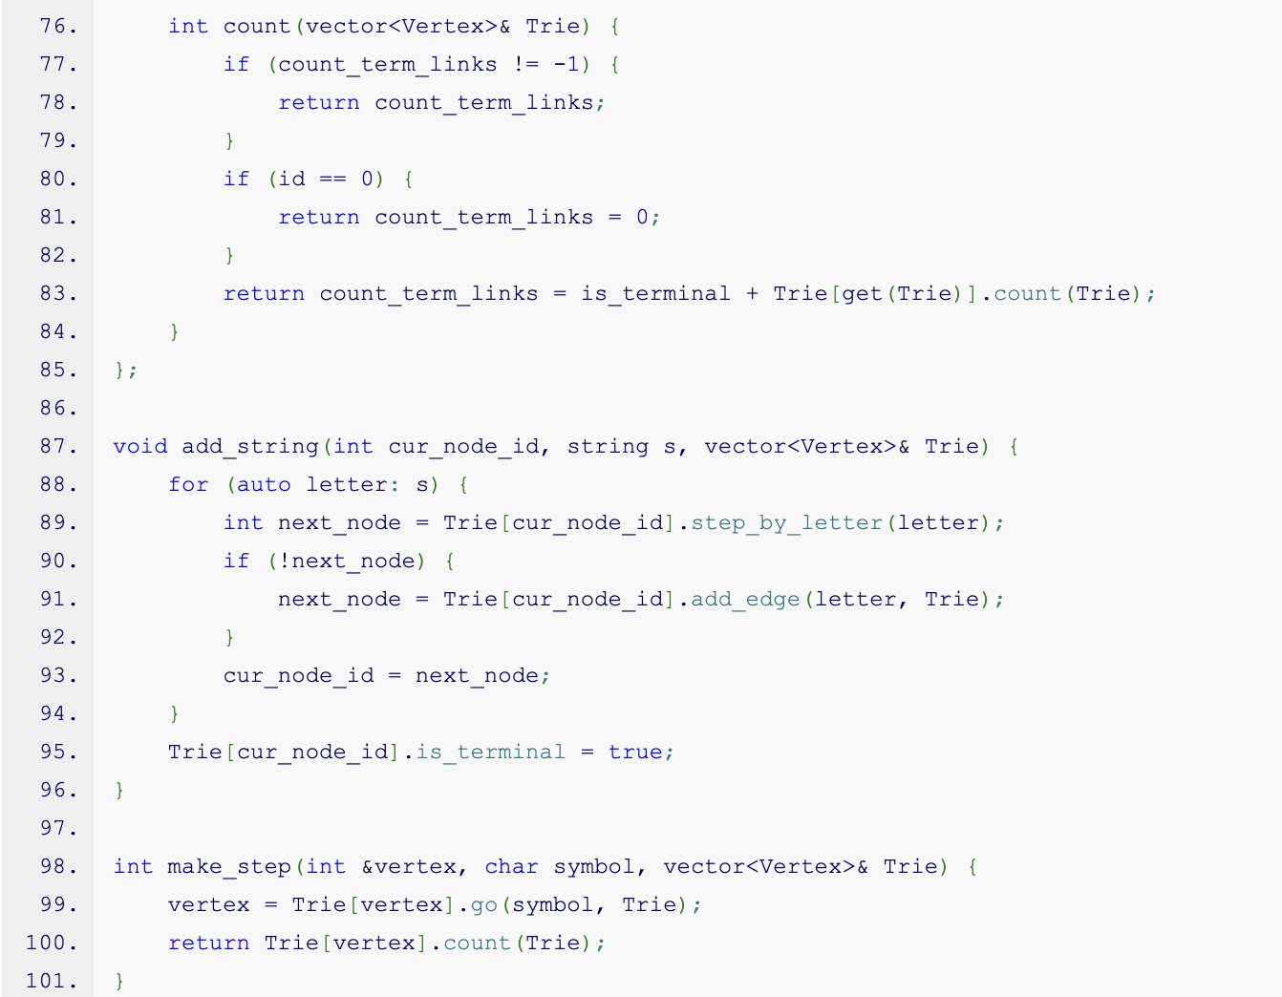

Slide 117
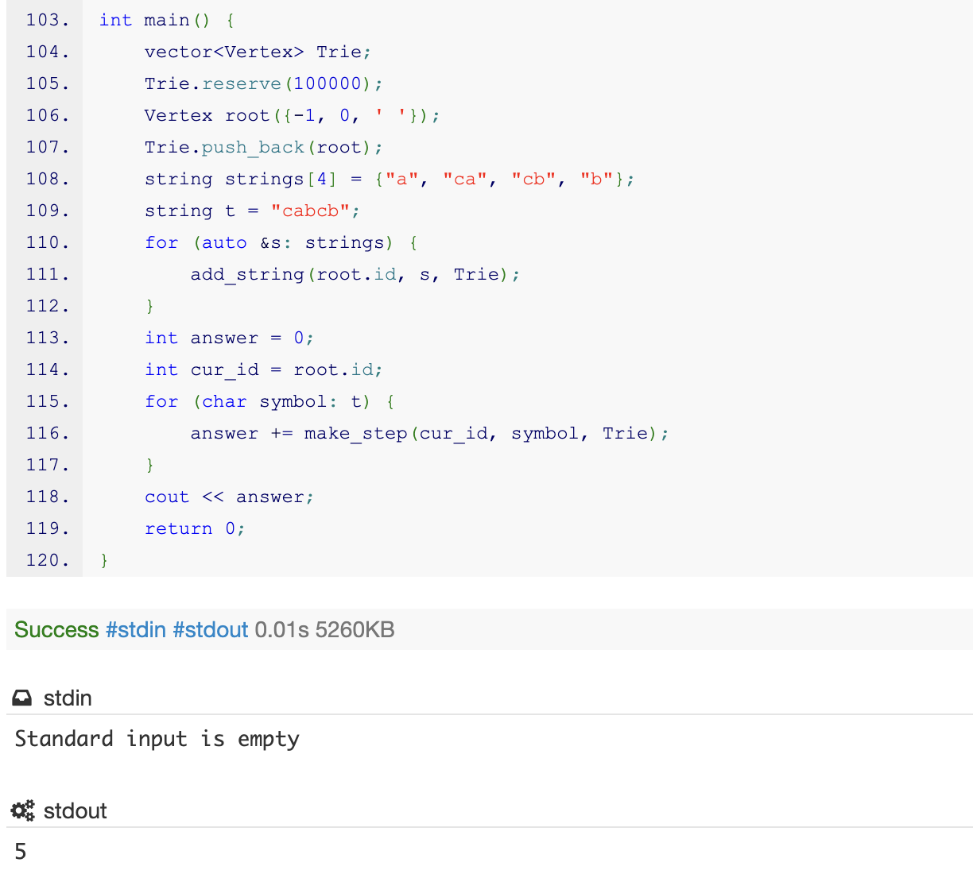

Slide 118
Realisation
Why this code doesnt work, if i remove string with reserve.

Slide 119
All codes
Trie, pointers, map - https://ideone.com/RpnxtT
Trie, pointers, array - https://ideone.com/1lOBT8
Trie, vector, array - https://ideone.com/MyaFAC
Trie, vector, map - https://ideone.com/eUJ6sD
aho - https://ideone.com/Skfp23

